Slide 1



Identifying areas at risk for covid- 19 and other disasters
Emiko Sano
Minoo Taghavi
Cameron Vann
General Assembly, Washington- DC

Slide 2

Problem statement
1- California Counties
2- COVID-19 and risk/exposure to other Natural disasters such as fire and earthquake.

Slide 3
Solution
Use Mapping to…
1
Track the covid-19 heatmap in real-time.
2
Track the regions with natural disasters such as Fire and Earthquake.
3
Identify CA counties at risk with COVID/ natural disasters.
4
Locate hot spots where people need assistance.
5

Slide 4
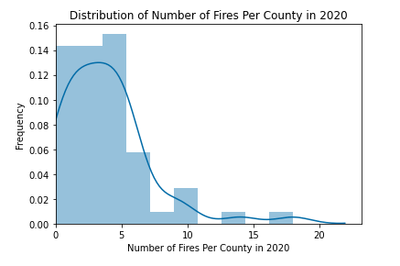

Fires data

Slide 5
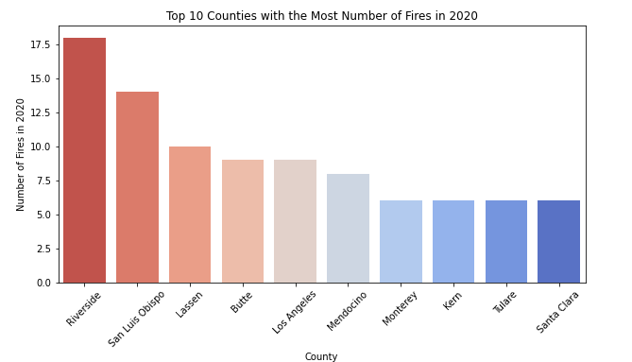
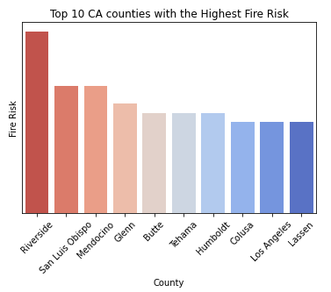
Fires DATA
Fire scores: (fire extend classification * number of fires) + (active fires * number of fires)

Slide 6

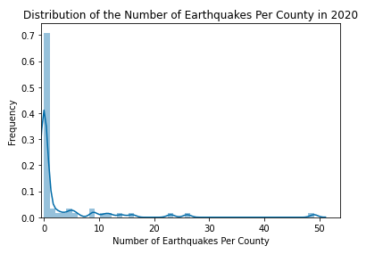

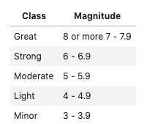
EARTHQUAKE DATA
Earthquake scores: magnitude classification * number of earthquakes

Slide 7
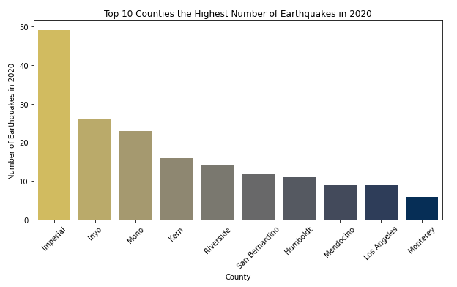
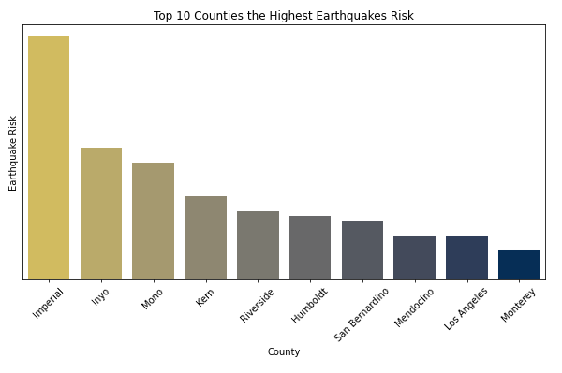
EARTHQUAKE DATA

Slide 8
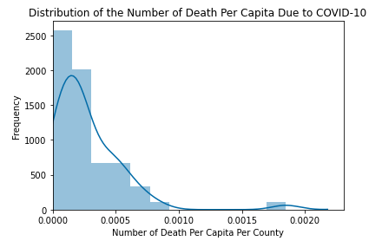
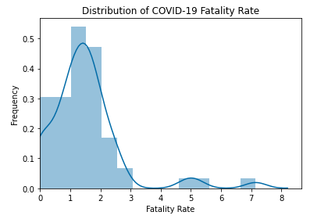
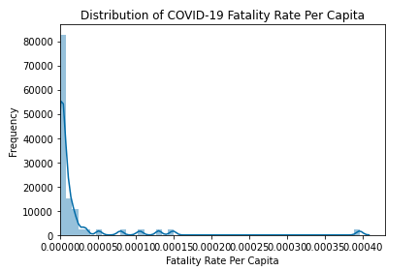

COVID 19 DATA

Slide 9
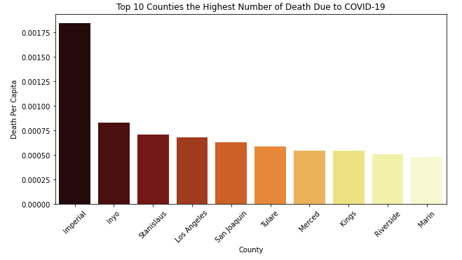
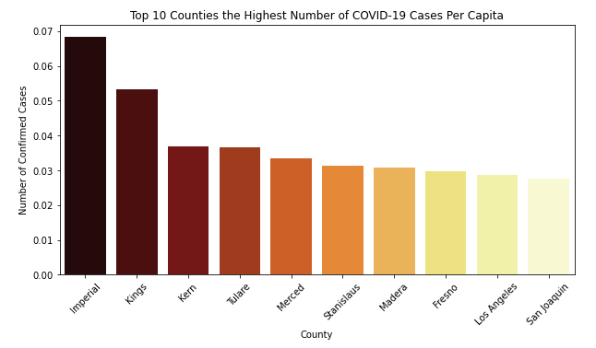
Covid-19 data

Slide 10
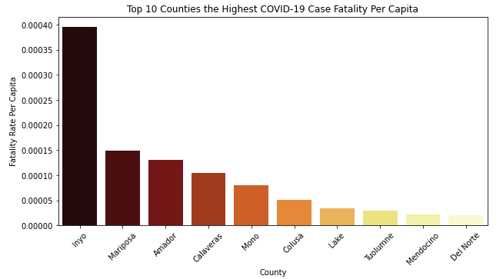
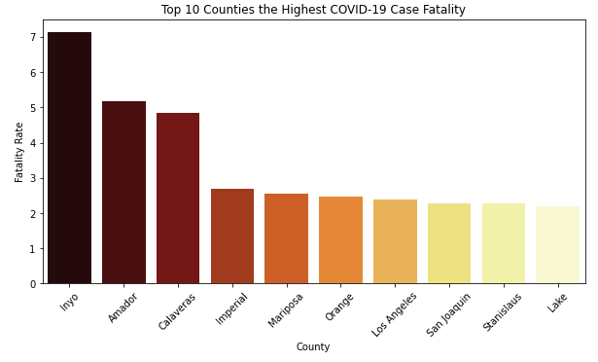
Covid-19 data

